Slide 1
DECLARATIVE PROGRAMMING PARADIGM

Slide 2
INTRODUCTION
Declarative programming is a programming paradigm that expresses the logic of a computation without describing its control flow.
This paradigm often considers programs as theories of a formal logic, and computations as deductions in that logic space.
Declarative programming is often defined as any style of programming that is not imperative.
Common declarative languages include those of database query languages (SQL), logic programming, functional programming, etc.

Slide 3
HISTORY
DECLARATIVE
FUNCTIONAL
- Lambda calculus
- Lisp
LOGIC
- First Order Logic
- Prolog

Slide 4
OVERVIEW
A program that describes what computation should be performed and not how to compute it. Non-imperative, non-procedural.
Any programming language that lacks side effects(example: a function might modify a global variable or static variable, modify one of its arguments, raise an exception,).
A language with a clear correspondence to mathematical logic.

Slide 5
OVERVIEW – Logic Paradigm
Computing takes place over the domain of all terms defined over a “universal” alphabet.
Values are assigned to variables by means of automatically generated substitutions, called most general unifiers. These values may contain variables, called logical variables.
The control is provided by a single mechanism: automatic backtracking.

Slide 6

Declarative Semantics Vs Imperative Semantics
In declarative semantics the meaning of a given proposition in a logic programming language can be concisely determined from the statement itself.
In an imperative language, the semantics of a simple assignment statement requires examination local declarations, scoping rules of the language, types of variables in the assignment statement, depends on its run-time context.

Slide 7
SQL - Structured Query Language
SQL is the standard language used to communicate with a relational database.
It can be used to retrieve data from a database using a query but it can also be used to create , destroy as well as modify their structure.

Slide 8
SQL - ELEMENTS
The language is subdivided into several language elements, including:
Clauses
Expressions
Predicates
Queries
Statements

Slide 9
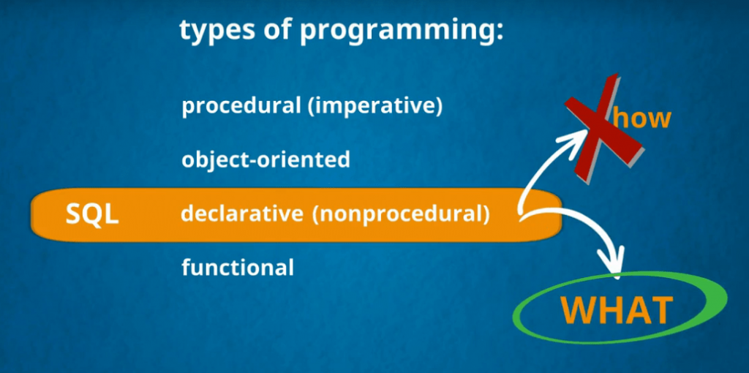

Slide 10
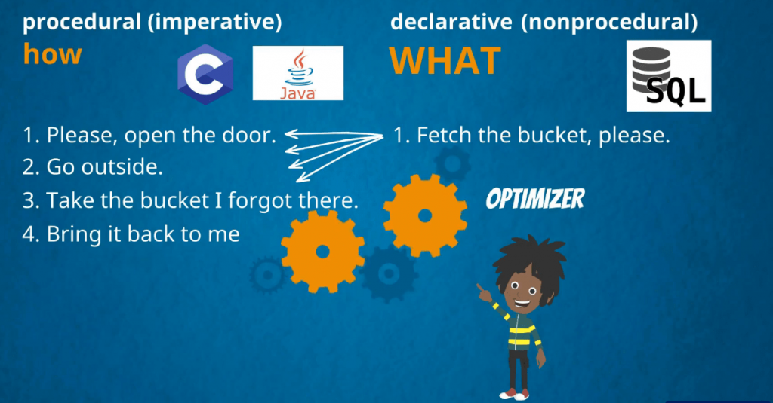

Slide 11
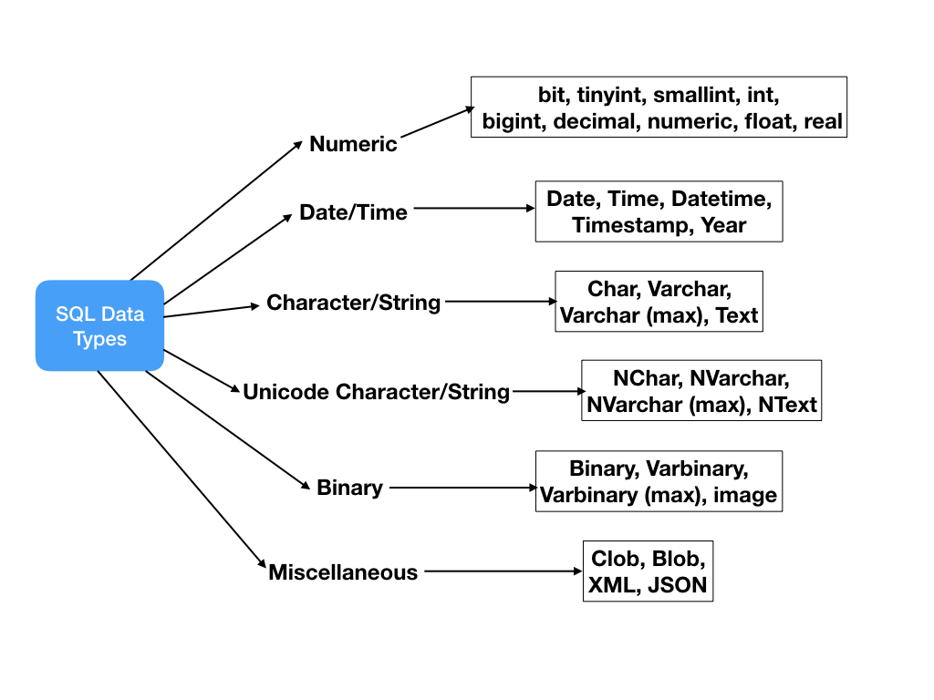
SQL – DATA TYPES

Slide 12
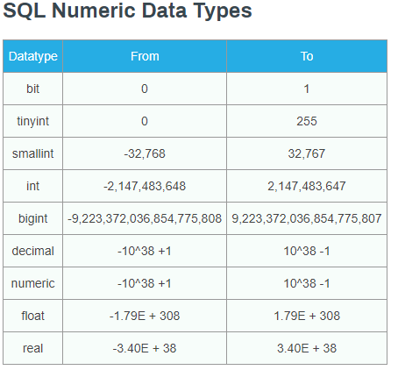

Slide 13
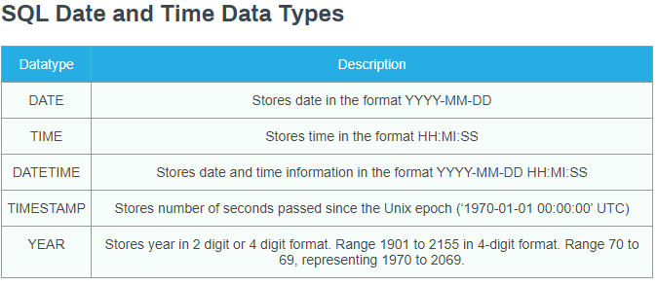

Slide 14
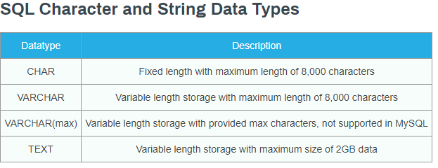

Slide 15
Some of The Most Important SQL Commands
SELECT - extracts data from a database
UPDATE - updates data in a database
DELETE - deletes data from a database
INSERT INTO - inserts new data into a database
CREATE DATABASE - creates a new database
ALTER DATABASE - modifies a database
CREATE TABLE - creates a new table
ALTER TABLE - modifies a table
DROP TABLE - deletes a table
CREATE INDEX - creates an index (search key)
DROP INDEX - deletes an index

Slide 16
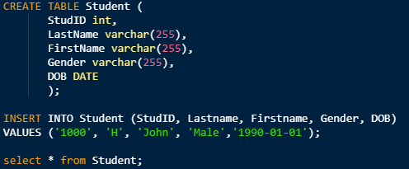
SQL EXAMPLES – INSERT INTO

Slide 17
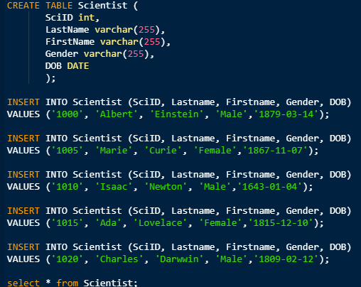


Slide 18

WHERE CLAUSE

Slide 19
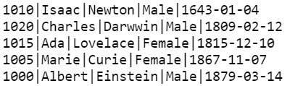
ORDER BY

Slide 20
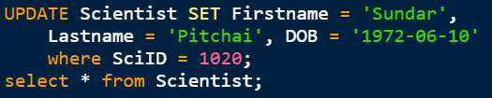
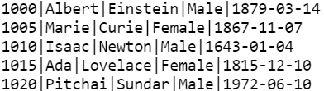
UPDATE

Slide 21
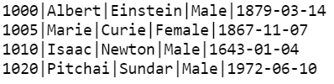
DELETE

Slide 22
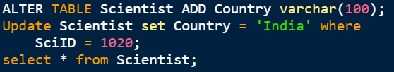

ALTER – ADD COLUMN
A

Slide 23

ALTER – DELETE COLUMN
In SQLite V3.20.1 it is not possible to rename a column, remove a column, or add or remove constraints from a table.

Slide 24
MARKUP LANGUAGE
Many markup languages such as HTML, MXML, XAML are often declarative.
XAML (Extensible Application Markup Language) is a declarative XML-based language that is used for initializing structured values and objects. It is used extensively in .NET Framework 3.0 and .NET Framework 4.0 technologies, particularly WPF (Windows Presentation Foundation), Silverlight, Windows Store Apps…
In WPF, XAML forms a user interface markup language to define UI elements, data binding, eventing, and other features. Anything that is created or implemented in XAML can be expressed using a more traditional .NET language such as C# or Visual Basic .NET.

Slide 25
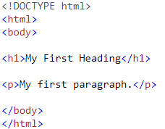


Slide 26
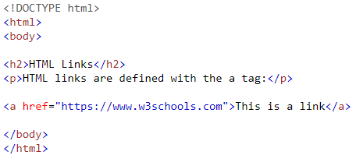
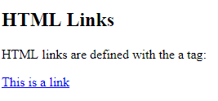

Slide 27
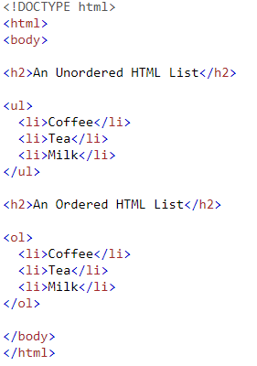
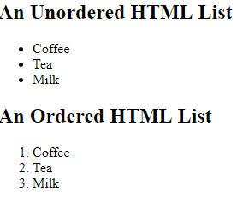

Slide 28
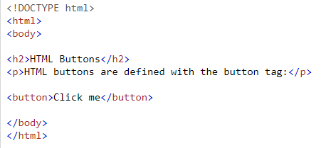
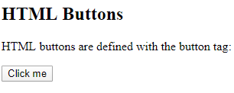

Slide 29
Demo

Slide 30
SQL EXAMPLES – INSERT INTO

Slide 31
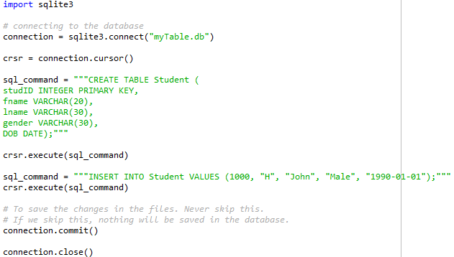
SQL in PYTHON

Slide 32
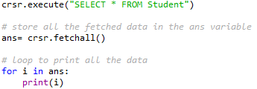

Slide 34
